Slide 1
Key Stage Two Curriculum Meeting
Year 5 Mrs Coyle
Year 6 Mr McEldowney
Year 7 Mrs Logue

Slide 2
Timetables and Routines in a KS2 Classroom
9.00 – 9.30 Collect and set homework
9.30 – 10.30 Literacy
10.45 – 11.00 Mental Maths
11.00 – 12.00/12.15 Maths
Afternoons
World Around Us P.D.M.U
R.E. P.E The Arts Irish
Accelerated Reading 15 mins/day.

Slide 3
What changes can I expect for my child in KS2?
Homework - One of the main changes in Y5 is pupils having both Numeracy and Literacy every night from Monday to Thursday –
Although sometimes the Homework may be a ‘Finding Out’ or a ‘Learning’ Homework.
Pupils should use the Traffic Light system on their Homework so that the teacher can find out the level of difficulty experienced by each child.

Slide 4
What changes can I expect for my child in KS2?
Sport
In Key Stage One the pupils had Fundamentals for PE with Ciaran – now in KS2 they will have
Gaelic Football on a Monday
Hurling/Camogie on a Tuesday
Swimming on a Wednesday for one term and Meadowbank for another term
Year Seven also have Mr Lockhart from St. Pat’s for 6 Friday sessions

Slide 5
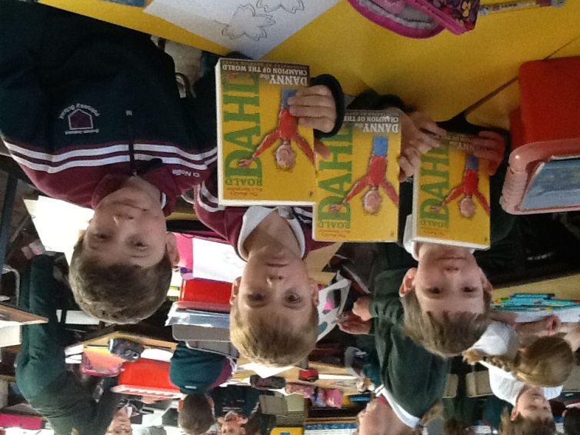
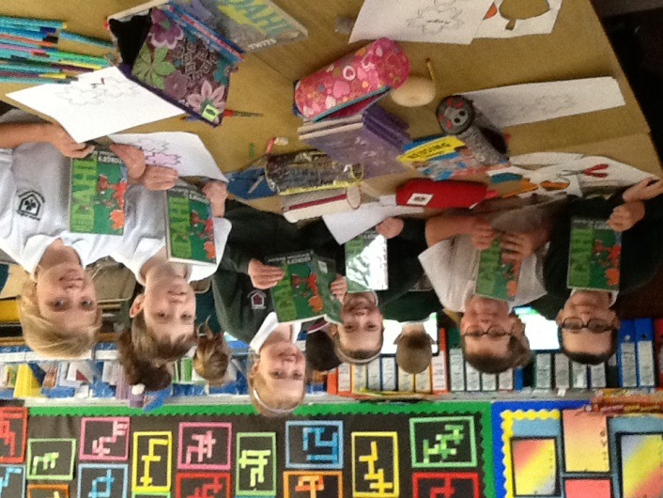
What changes can I expect for my child in KS2?
Emphasis on Reading in KS2 is about encouraging the pupils to become more independent in their reading.
We focus on the understanding of what they have read rather than hearing them ‘repeat’ reading that they have done at home. Therefore in KS2 the focus is on a class novel and their Accelerated Reading programme.

Slide 6
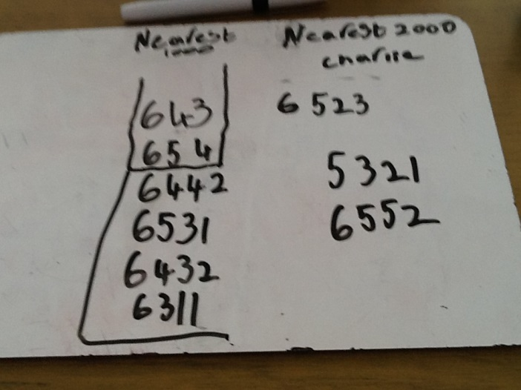
Numeracy
Area of Numeracy developed in
Key Stage 2 are
Number
Measures
Shape & Space
Information Handling
Pupils will further develop their problem solving skills, looking for ways to overcome difficulties.
More emphasis on the language of maths, explain their thinking and discuss their work.
These skills will be developed using Heinemann Active Maths and Heinemann Maths.

Slide 7
Assessment
Types of Assessment
Informal Monitoring
Assessment for learning
Self-assessment
Peer – assessment
Friday Tests
End of topic
End of term
Accelerated Reading Tests and Star Reading Tests
GL Assessments (May)

Slide 8
Special Educational Needs
Small groups of children are withdrawn from each class for extra help in Literacy and Numeracy with Miss Grant.
These children are chosen after GL Test scores have been analysed by the class teachers and the SENCO.

Slide 9
Thinking Skills & Personal Capabilities
Children have the opportunity to develop knowledge, skills and understanding through a more independent approach in school and at home. eg.
In World Around Us they complete independent research to help with their topic work and have the chance to produce information in written and digital forms eg.
PowerPoint presentations, project files and film making (Internet Safety Video)

Slide 10
Outside Visits/ Tutors
Year 6/7 Irish lessons every Friday for ½ hour slot. Year 5 will have Irish for 6 sessions.
School Trips.
Y 5 Co-op visit -Y 6 Salmon Farm Y 6
Shared Education Project with Eden P.S.
Year 7 - Overnight trip to Woodhall Outdoor Recreational Centre.
Year 7 - 5 week Science Course in St Pats.

Slide 11
Standards of Presentation and Behaviour
Classwork and homework will always include :Date Title and Page Number or Task Number.
Care should be taken with spelling, punctuation and handwriting.
Children must use Traffic Light System on all homework tasks.
Children are expected to represent their school and local community in a proper, well behaved and mannerly fashion when on all outside visits.

Slide 12
Shared Education
Our partner school is Eden P.S. Ballymoney
Year 5 6 &7 participate in shared lessons which are taught in both schools.
Children work with the partner school in lessons relevant to their class learning and topics.
The Shared Education Programme runs over 2 terms per year

Slide 13
Frequently Asked Questions
Do you think I should get my child a Tutor?
What Post Primary school is best for my child?
What band (in St Pats) will my child be placed in ?

