Slide 1
Key Stage 1 Curriculum Meeting
Year 3 and 4
Sarah McNicholl
Sinead McErlane
www.stjohnsswatragh.com

Slide 2
Our Vision
Our vision and values are at the core of everything we do. They underpin our teaching and learning, and provide an environment which prepares our pupils as confident, happy citizens.
‘Education for Today and Tomorrow’

Slide 3
Children at Key Stage 1 will build and develop the experiences provided at the Foundation Stage.
Learning at Key Stage 1 will continue to foster the intellectual, social, emotional, physical, cultural, moral and spiritual development of children.

Slide 4
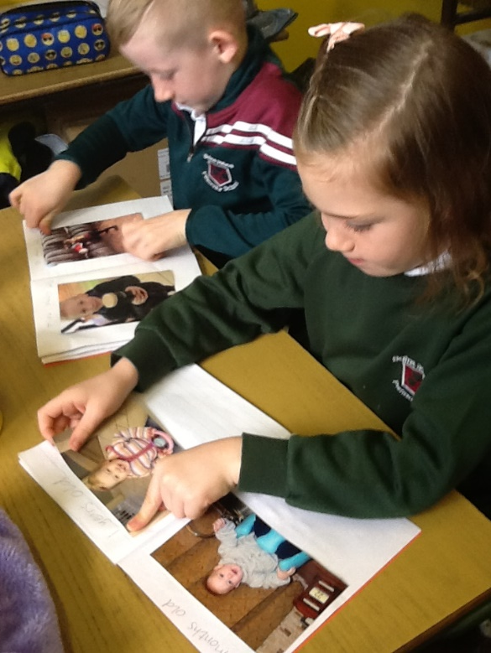
self-confidence and self-esteem
developing the knowledge, understanding and skills
positive attitudes to learning
continuing to develop children’s creativity
challenging, relevant and enjoyable
individual needs

Slide 5
Routines
Morning
Teacher time
Handwriting
Mental Maths
Maths
Guided reading
Comprehension
Grammar
Phonics
Writing
Afternoon
The World Around Us
Religion
The Arts
Physical Education
PDMU
Irish

Slide 6
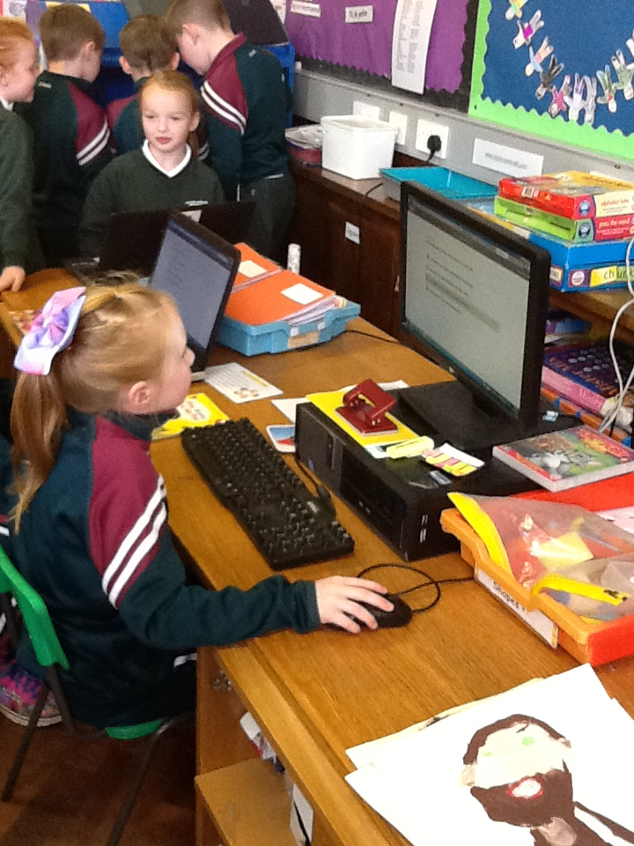
Reading/Literacy/Using Communication
Pupils grouped according to ability
Movement between groups throughout the year
Handwriting and presentation
Mixture of active learning and written work
Accelerated Reader

Slide 7
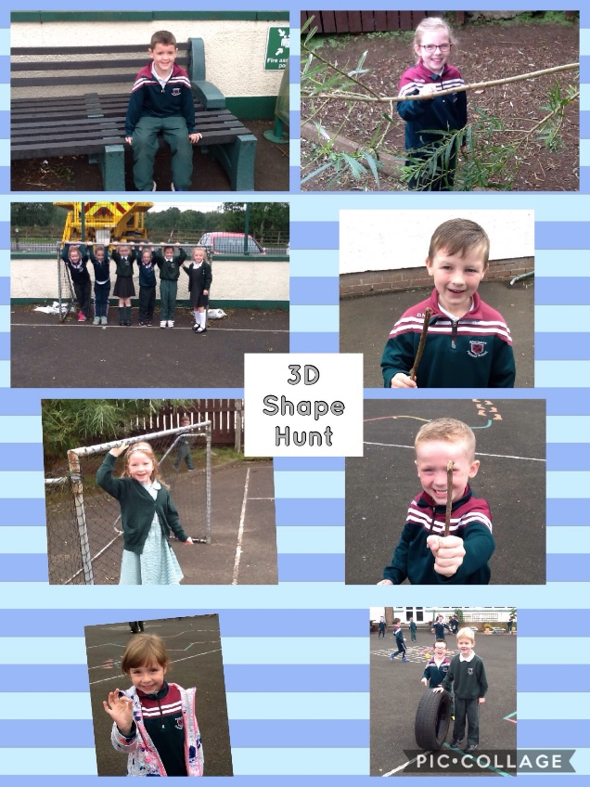
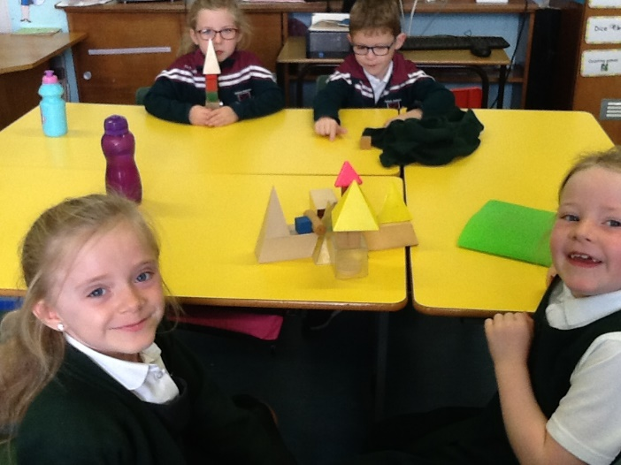
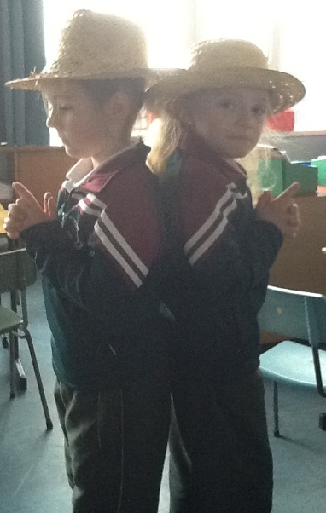
Numeracy / Using Maths
Grouped according to ability
Movement between groups (depending on topic)
Practical work
Recording in various formats
Active Learn (Home link)

Slide 8
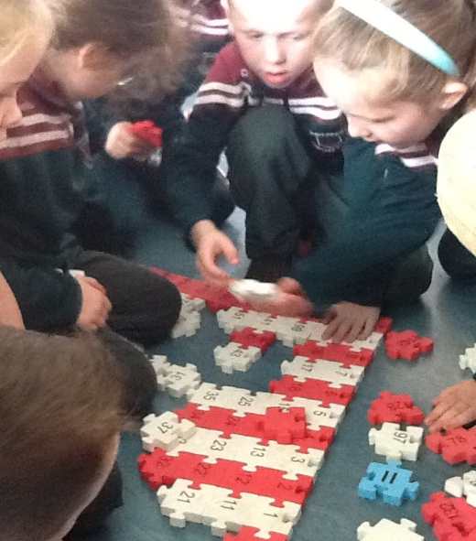
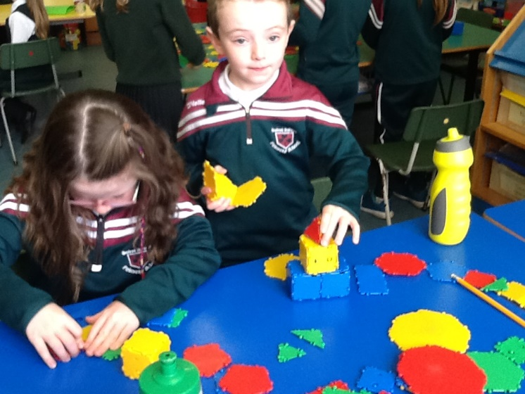
Play at Key Stage 1 (Activity Based Learning)
During play children should be given opportunities to:
Manage Information
Think, solve problems and make decisions
Be creative
Work with others
Self-manage
Notes:
MANAGE INFORMATION
Asking, accessing, selecting, recording, integrating,
Communicating
WORK WITH OTHERS
Being collaborative, being sensitive to others’ feelings, being fair
and responsible
BE CREATIVE
Imagining, generating, inventing, taking risks for learning
SELF-MANAGE
Evaluating strengths and weaknesses, setting goals and targets,
managing and regulating self

Slide 9
Homework
See additional Homework Policy
Record of Homework in diary
Literacy (spelling)
Maths
Mental Maths
Reading
Religion – Grow in Love
Smiley Faces/Traffic Lights

Slide 10
Additional Educational Needs
Monitoring
Record of Concern
Individual Education Plan
Group Education Plan
Special Needs Teacher
Challenge Club (Year 4)
Reading Partners
Dyslexia Screener (Year 4)
* Home-School Link *

Slide 11
Assessment
Assessment gives teachers a better awareness of what pupils know and understand, what their learning experiences enable them to do and what their skills and personal capabilities are.
Types of Assessment
Informal Monitoring
Assessment for learning
Self-assessment
Peer – assessment
Friday Tests
End of topic
End of term
Variety of reading tests
Computer Based Assessment (end of Year 3)

Slide 12
Strengths and Areas for Development
Class work
Homework
Class Tests (including class averages)
Individual Education Plan (IEP)
Parent/Teacher Meeting
End of Year Report

Slide 13
Concerns
Additional Information
Contact teacher/office in person or telephone call to arrange a suitable time
Parent/Teacher Meetings
Class Dojo message (private)
Written note to relevant person
Monthly Newsletter
School Website
Text Messages
School App

Slide 14
Outside Visits / Tutors
Fundamentals (Yr1-4)
Library (Yr4)
Young Enterprise (Yr2-7)
Music Tuition (Yr4-7)

Slide 15
Useful websites
www.stjohnsswatragh.com
Active Learn
Woodlands Junior School

